Slide 1
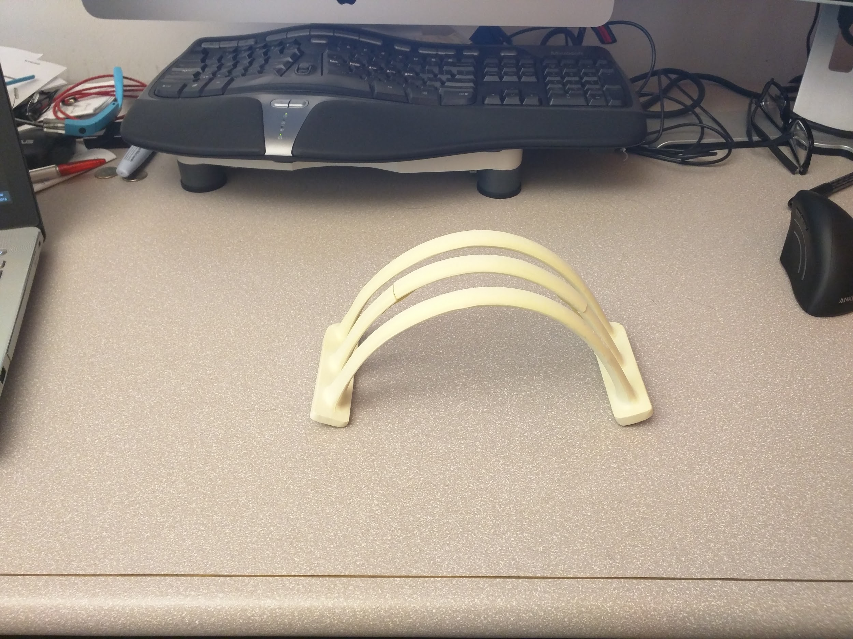
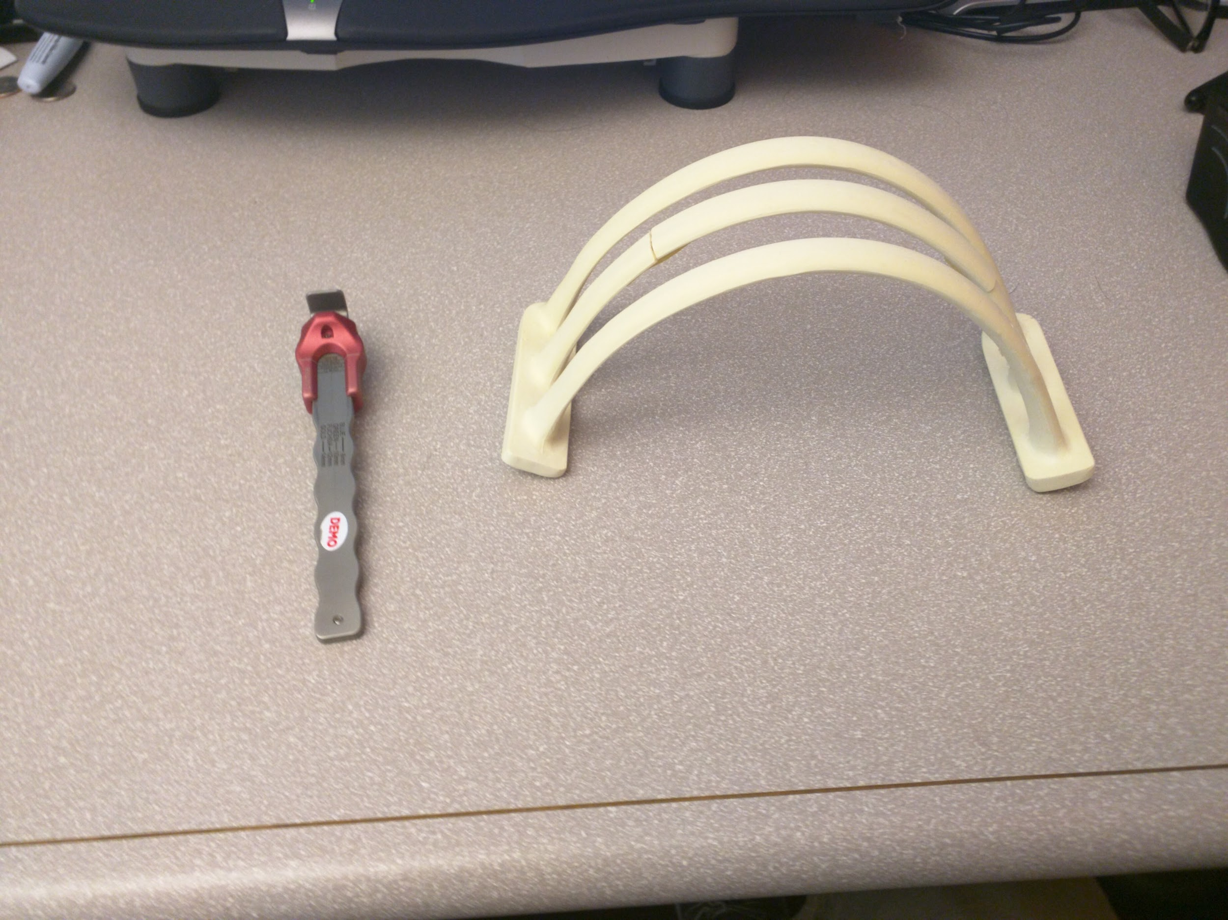
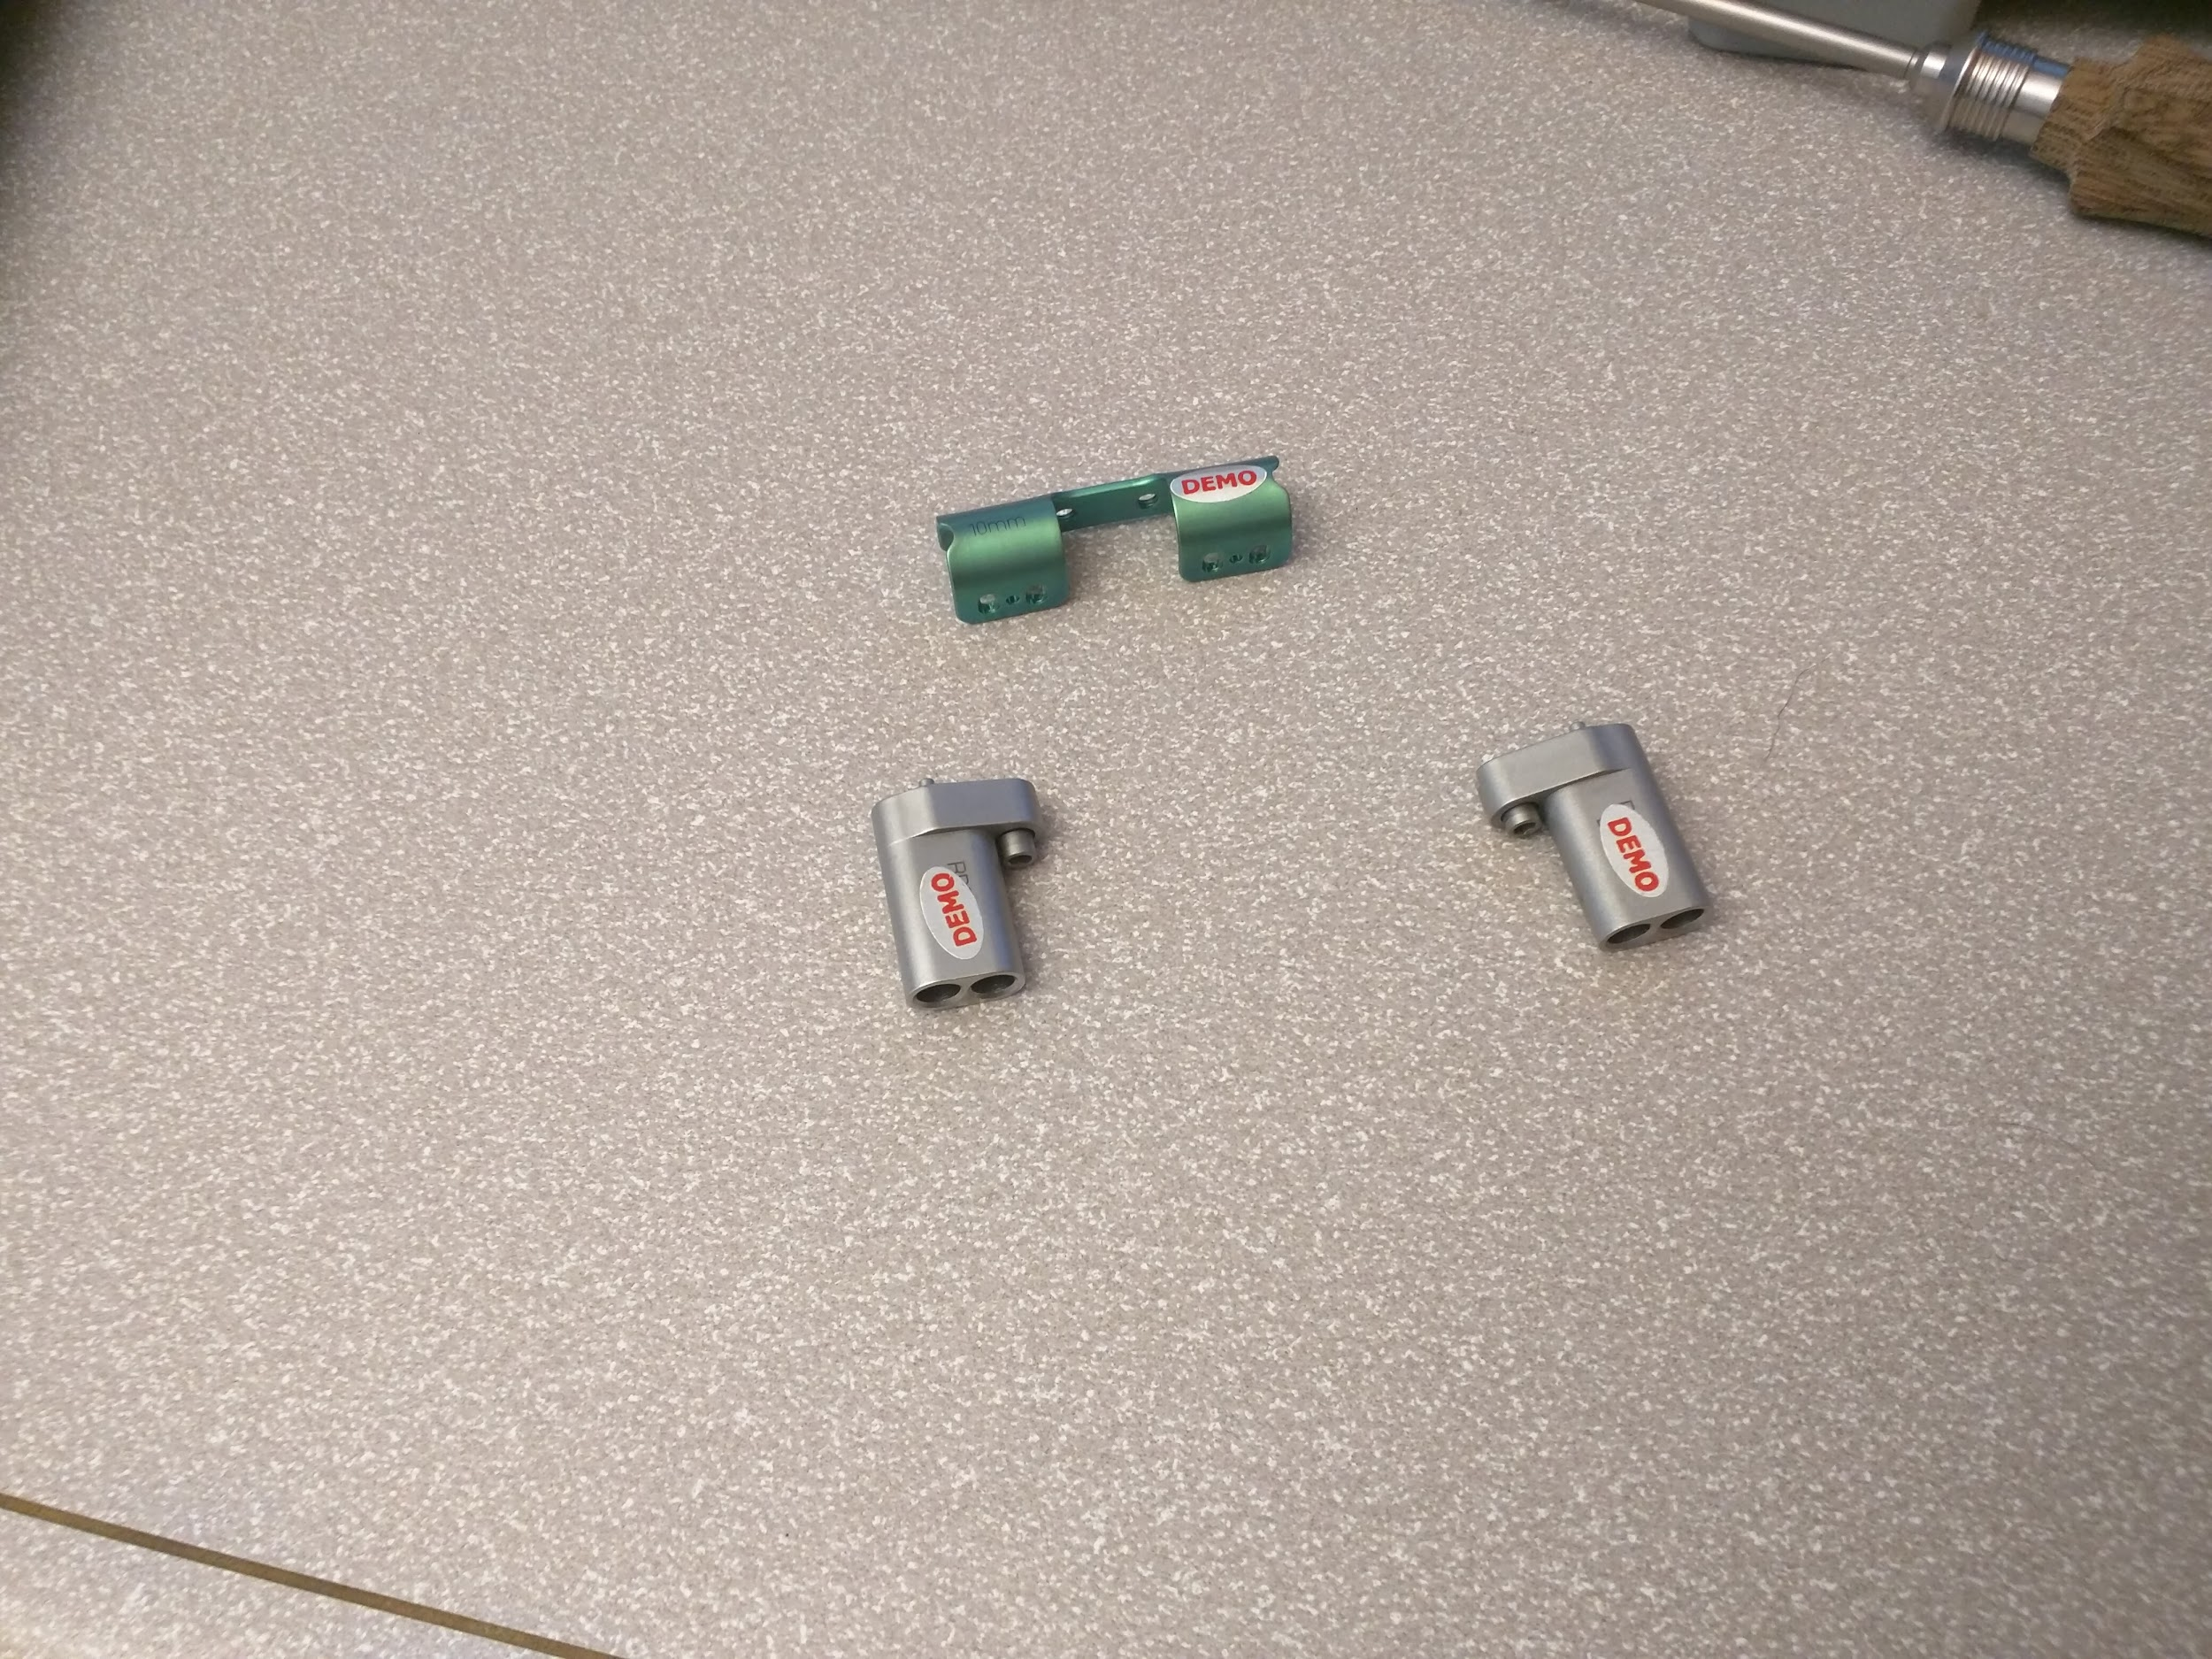
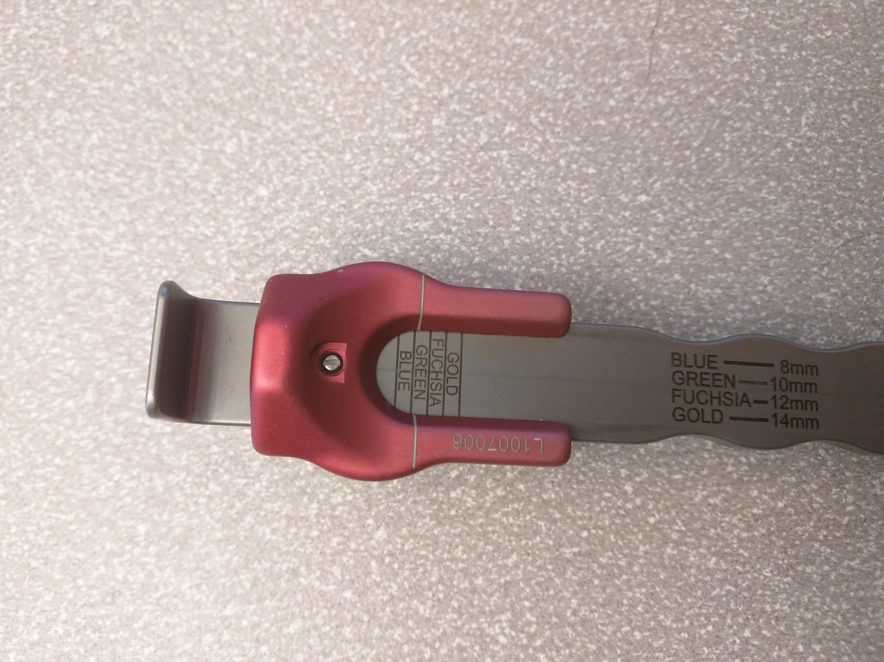
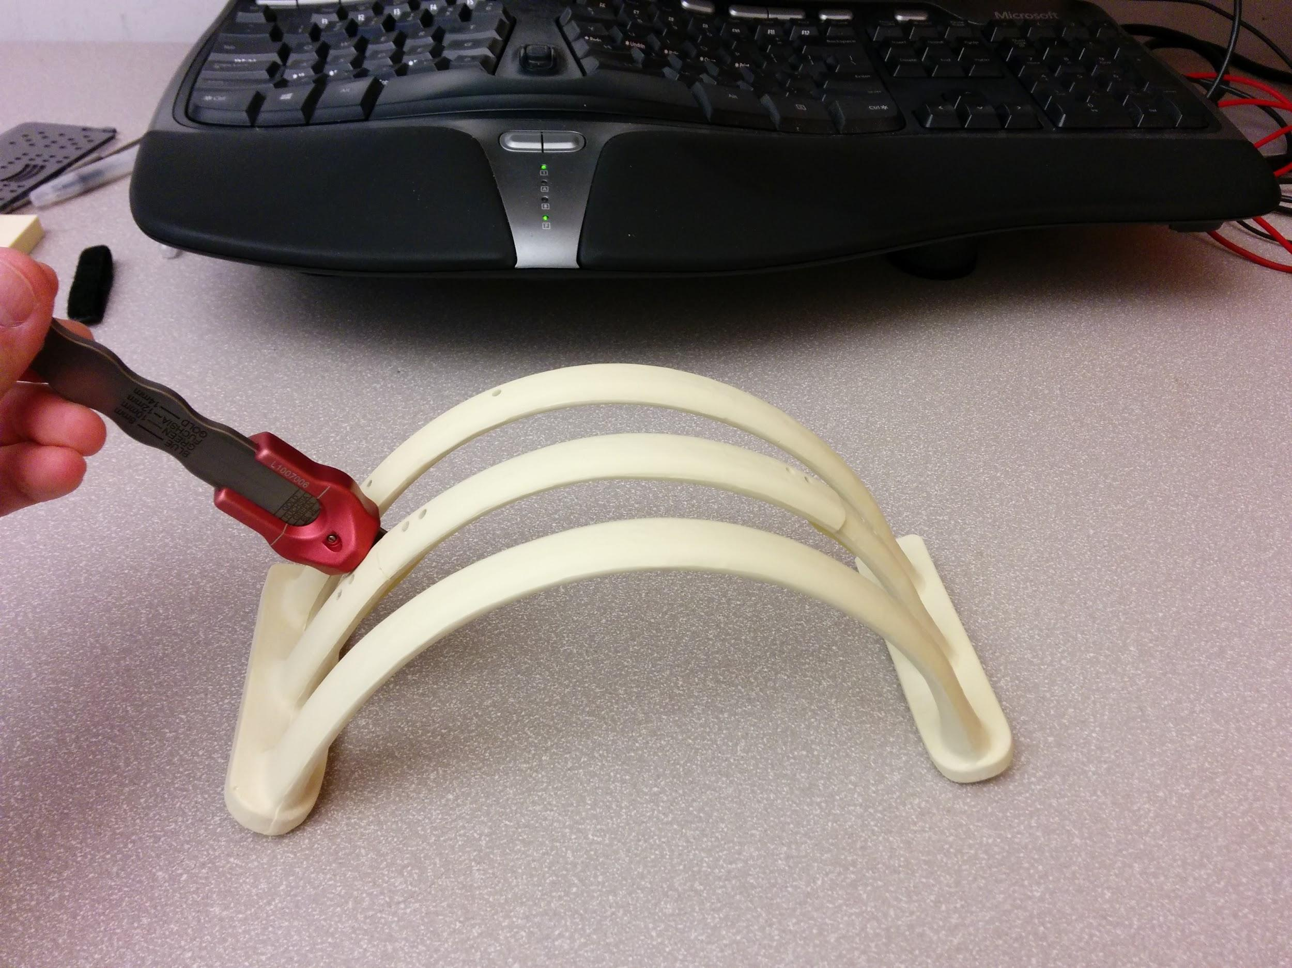
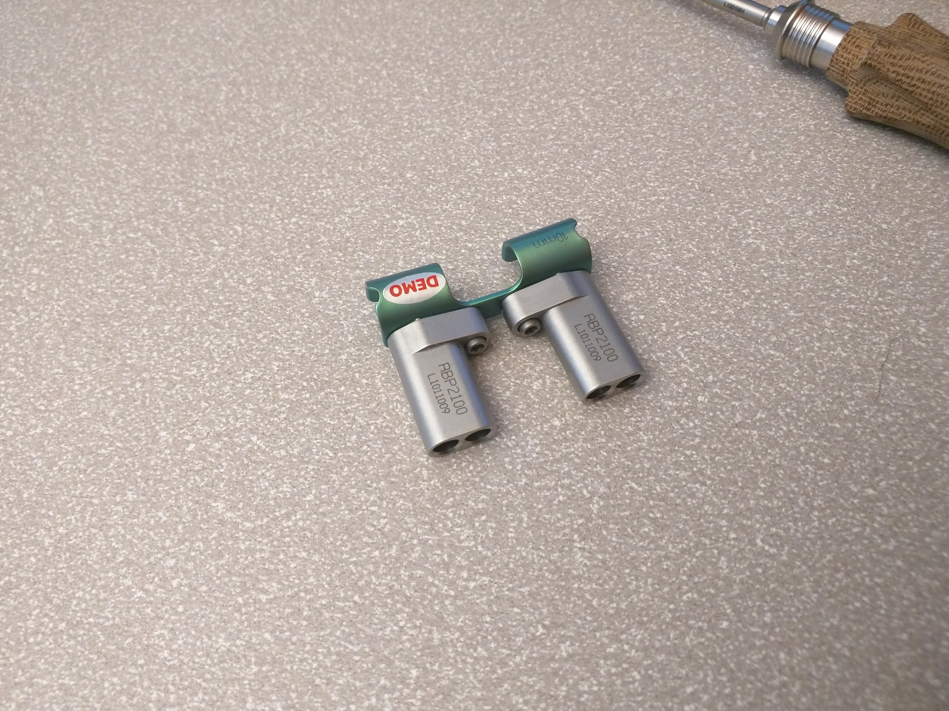
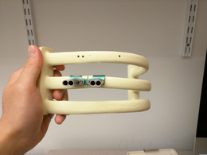
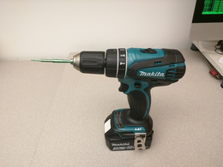
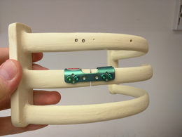
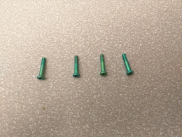
Start
Bone exists
“Put the bone on the table.”
“Now find the gauge and put it on the table.”
Error State
Error State
Gauge and Bone exist
“Good job. Now measure the bone thickness.”
RibPlate is not Green
“You are using the wrong RibPlate. Please find the green one.”
Colors except “Green”
“The color is wrong. Please measure again and tell me the reading”
Gauge is placed at wrong position
User reads out “Green”
Gauge is at correct position wrt Bone
“Put the green RibPlate and two target guides on the table.”
Error State
“Great. Please read the color on the gauge”
“Please place the gauge near the fracture”
Target Guide and Green RibPlate exist
Error State
“Great. Now assemble the target guides onto the RibPlate.”
“ Please put it on the top edge.”
Put upside down
Assembled Piece is at over the top edge of the Bone
Drill driver is not green
Assembled
Error State
“Good. Put the RibPlate onto the fracture. Show me the sideview.”
“Put the green drill driver onto the power drill.”
"Please use the green drill driver."
Drill with green drill driver
“Drill through the target guides and find four green screws when done.”
Four green screws are placed inside the RibPlate on the bone
Four Green Screws exist
Finish
“Congratulations! You have finished.”
“Insert screws through the targeting guide and remove the targeting guide when done."

